Slide 1



ROAD ACCIDENT ANALYSIS
PROJECT
Presented by: Saeed

Slide 2

OVERVIEW
01
02
03
About Us
Attributes
Goals
04
05
06
Question
Dashboard
Thanks

Slide 3




ABOUT US
ABOUT
We are a dedicated team focused on analyzing road accidents to uncover critical insights for enhancing road safety and saving lives."

Slide 4





ATTRIBUTE
Age_band_of_driver
Sex_of_driver
Educational_level
Vehicle_driver_relation
Driving_experience
Lanes_or_Medians
Types_of_Junction
Road_surface_type
Light_conditions
Weather_conditions
Type_of_collision
Vehicle_movement
Pedestrian_movement
Cause_of_accident
Accident_severity
Time
Day_of_week
Number_of_casualties
Casualty_class
Number_of_vehicles_involvd
Road_allignment
Vehicle_Type

Slide 5

GOALS AND OBJECTIVES
Goals
Enhance road safety by identifying critical factors contributing to road accidents, ultimately reducing casualties and improving community well-being.
Objective
Utilize comprehensive data analysis to uncover trends and insights that inform effective policy-making, targeted interventions, and community awareness programs for safer road usage.

Slide 6
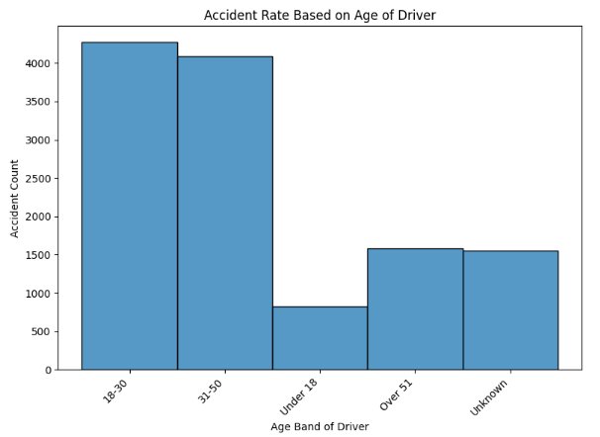
Insight:
Younger drivers exhibit higher accident rates compared to older drivers, indicating a need for targeted interventions for this age group.
Recommendation:
Introduce specialized driver education programs focused on safe driving practices and risk awareness for younger drivers to reduce accident rates.

Slide 7
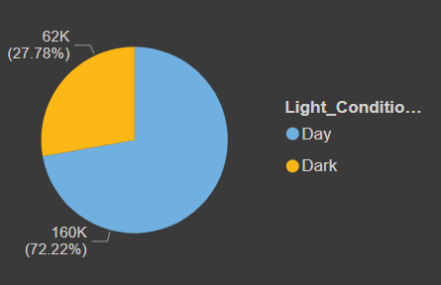
Insight:
Urban areas have more casualties than rural areas due to traffic density issues.
Recommendation
Launch targeted road safety campaigns and upgrade urban infrastructure to reduce casualties.

Slide 8
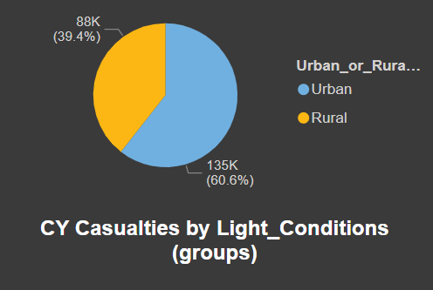
Insight:
Casualties are significantly higher during dark light conditions compared to daytime.
Recommendation:
Enhance street lighting and implement reflective road signage to improve visibility and reduce accidents at night.

Slide 9
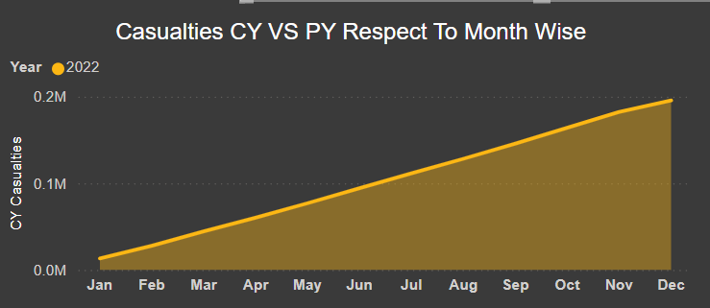
Insight:
Casualties fluctuate monthly, with higher rates observed during specific months, possibly linked to seasonal factors or holiday traffic.
Recommendation:
Analyze monthly data trends to develop targeted safety initiatives during high-casualty months, such as increased patrols or public awareness campaigns.

Slide 10
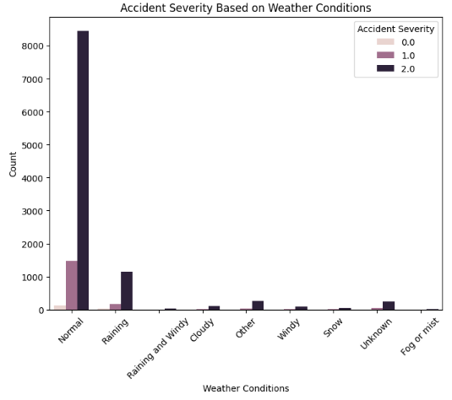
Insight:
Accident severity increases significantly during adverse weather conditions, such as rain and fog, compared to clear weather.
Recommendation:
Implement stricter driving regulations and public awareness campaigns during bad weather to mitigate risks and improve road safety.

Slide 11
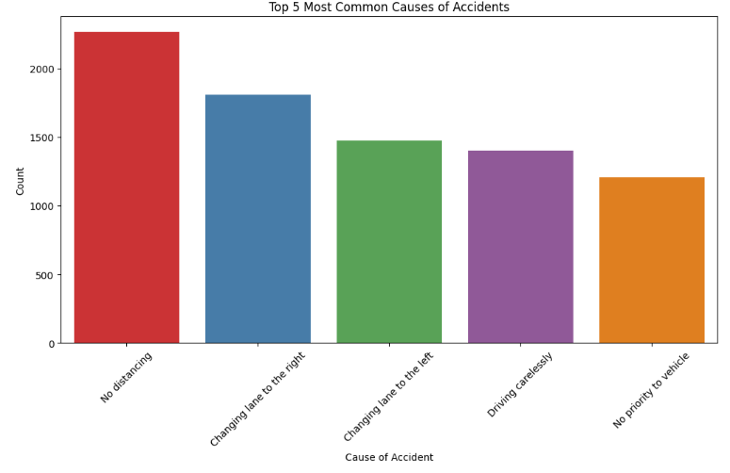
Insight:
The most common causes of accidents include distracted driving, speeding, and driving under the influence of alcohol or drugs.
Recommendation
Implement comprehensive awareness campaigns and stricter enforcement of traffic laws to address these key causes and enhance overall road safety.

Slide 12
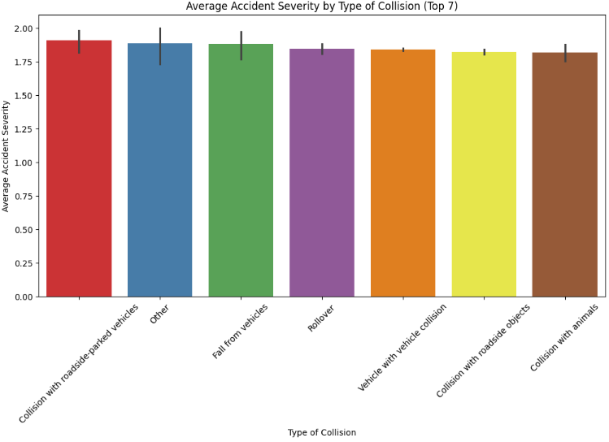
Recommendation
Enhance roadside safety measures and driver awareness programs to reduce the severity of these collision types.

Slide 13
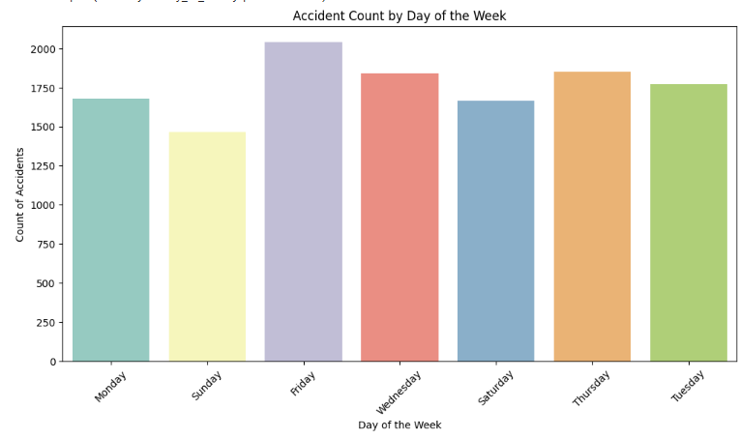
Insight:
Fridays experience a higher number of accidents compared to other days, possibly due to increased end-of-week celebrations and weekend travel
Recommendation:
Implement targeted safety campaigns and increased patrols on Fridays to address the spike in accidents and promote responsible driving.

Slide 14
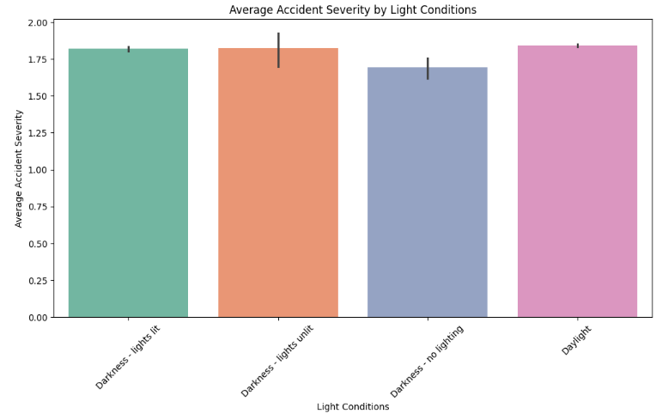
Insight:
Increased severity compared to well-lit areas, but less than total darkness.
Recommendation
Invest in better street lighting in dark and dimly lit areas and encourage safer driving practices during low visibility conditions to minimize accident severity.

Slide 15
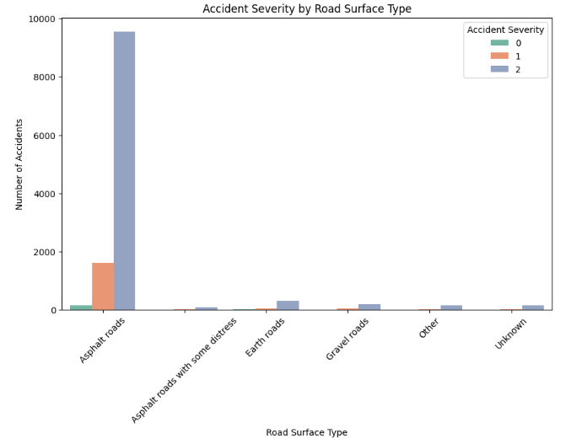
Insight:
Accidents on asphalt surfaces may occur less frequently compared to other surfaces but can still result in significant severity during adverse conditions, such as rain or ice
Recommendation:
Regularly maintain and inspect asphalt surfaces to ensure optimal traction and safety, and educate drivers on adjusting their driving behavior under varying weather conditions to prevent accidents.

Slide 16
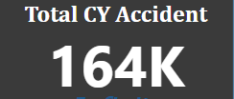
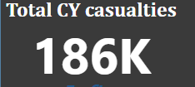
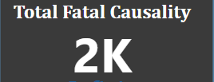
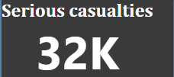

Slide 17
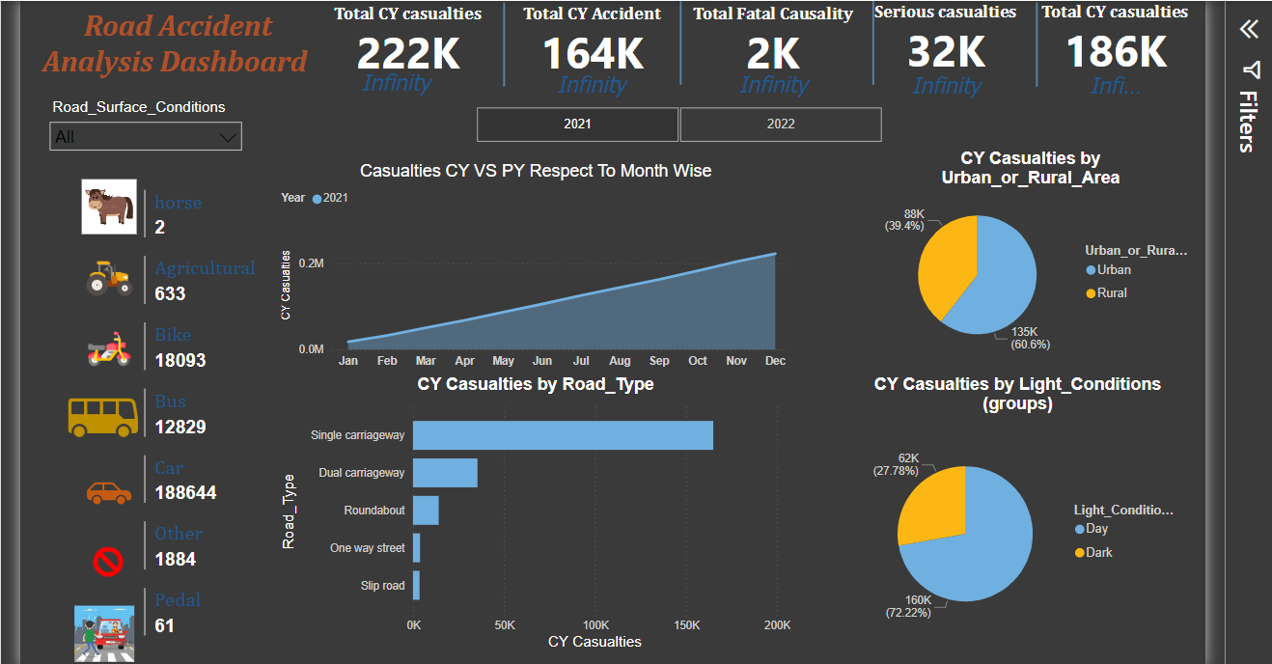

Slide 18


Thank's

